Slide 1

Children’s Mental Health Week
1-7 February 2021
Assembly slides for primary-age children

Slide 2
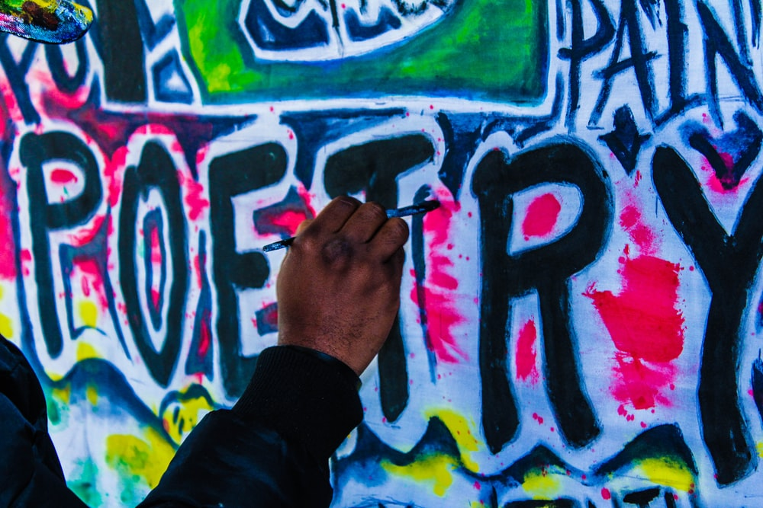
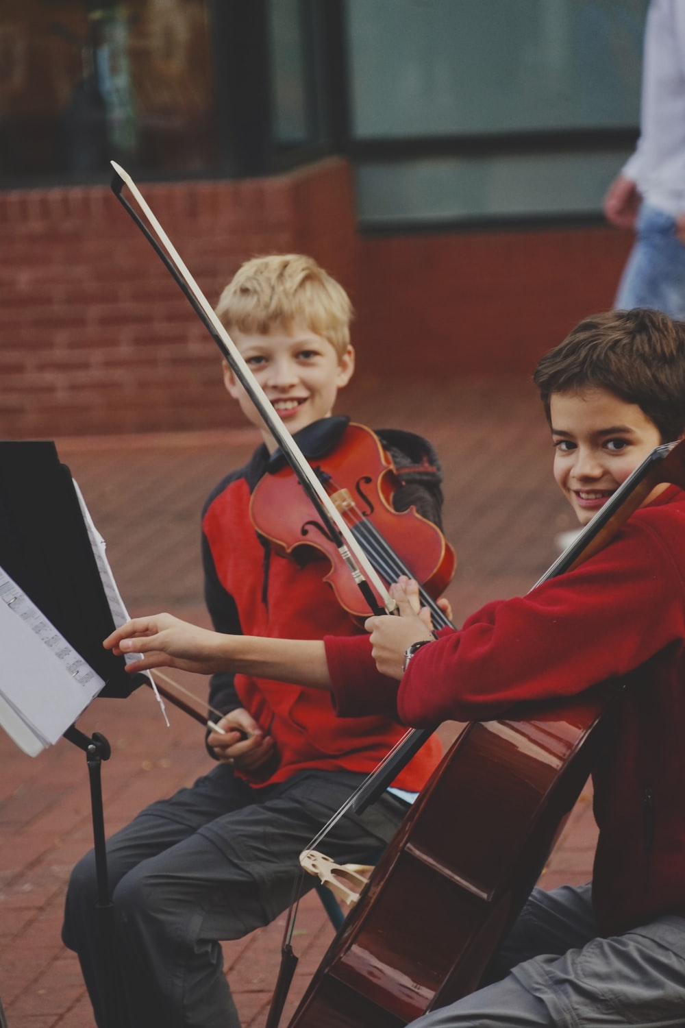
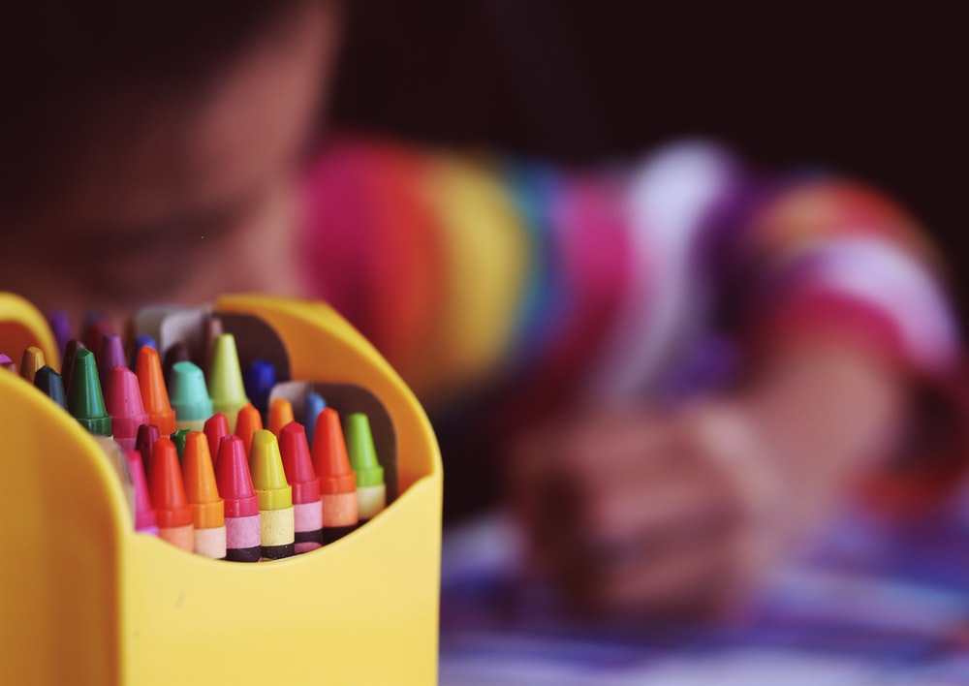

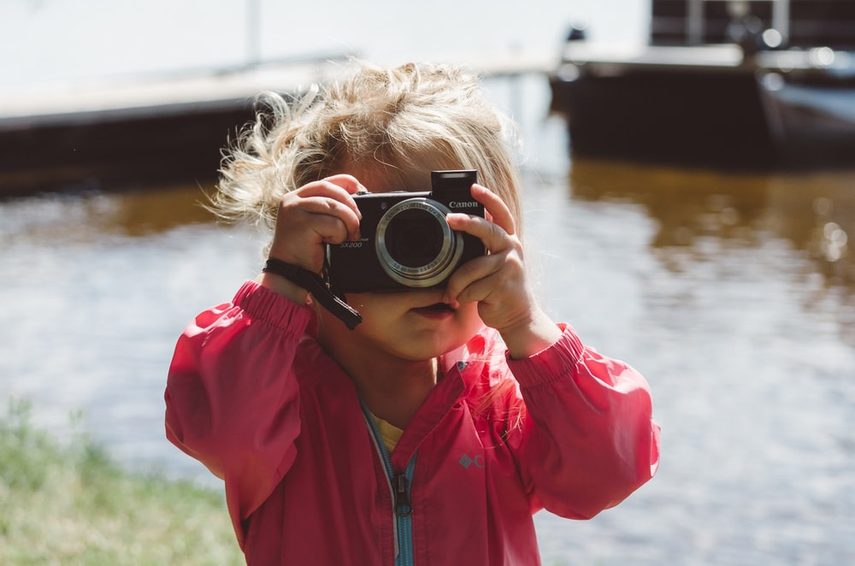
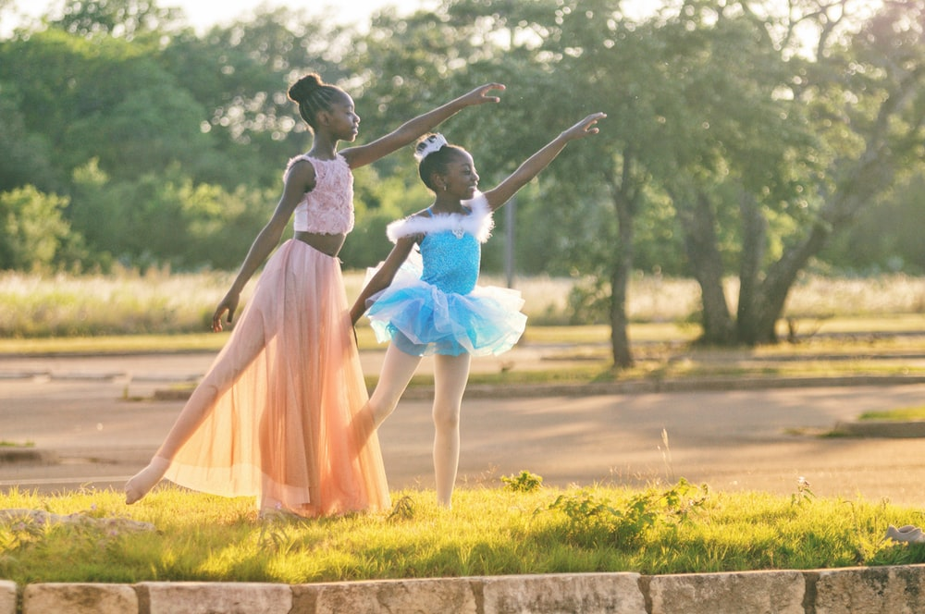
Slide 2

Slide 3

Slide 3

Slide 4

Slide 4

Slide 5

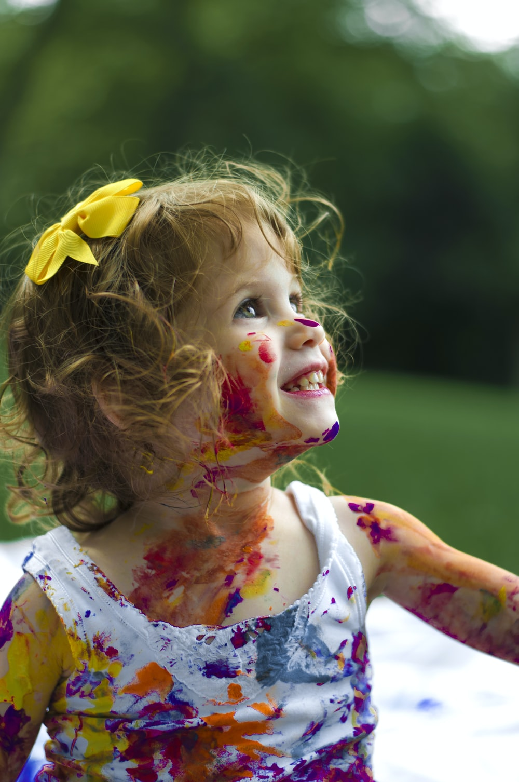
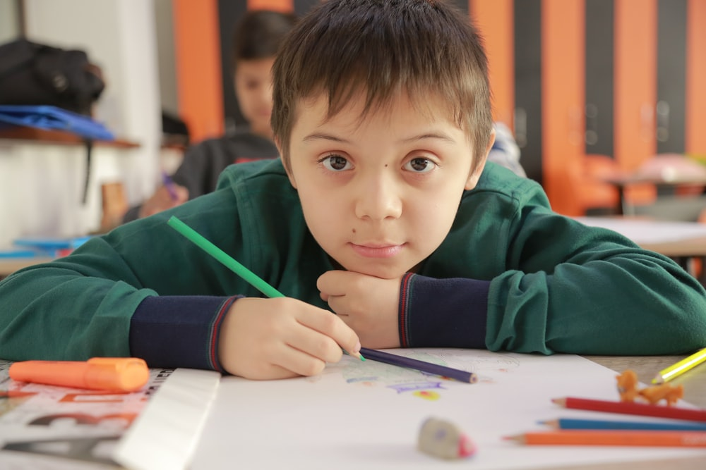
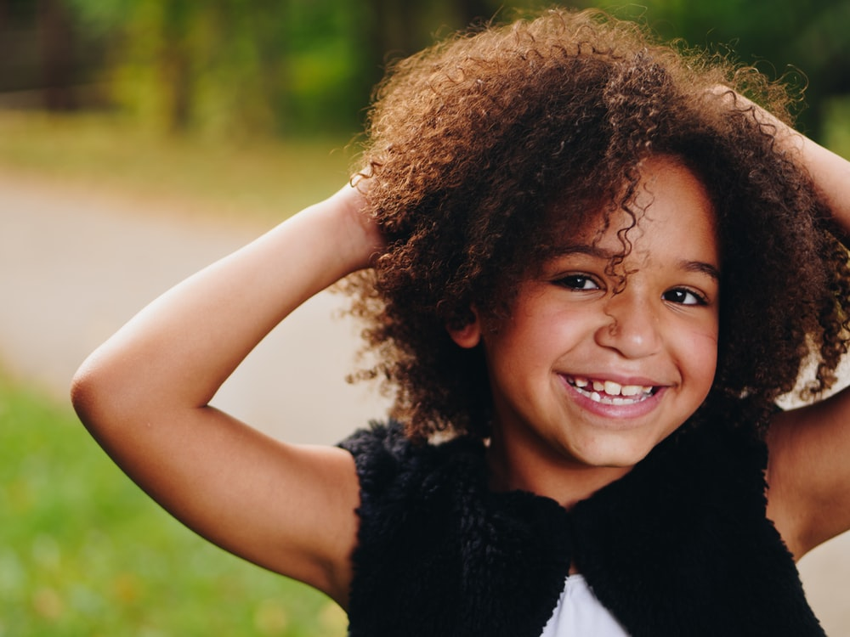
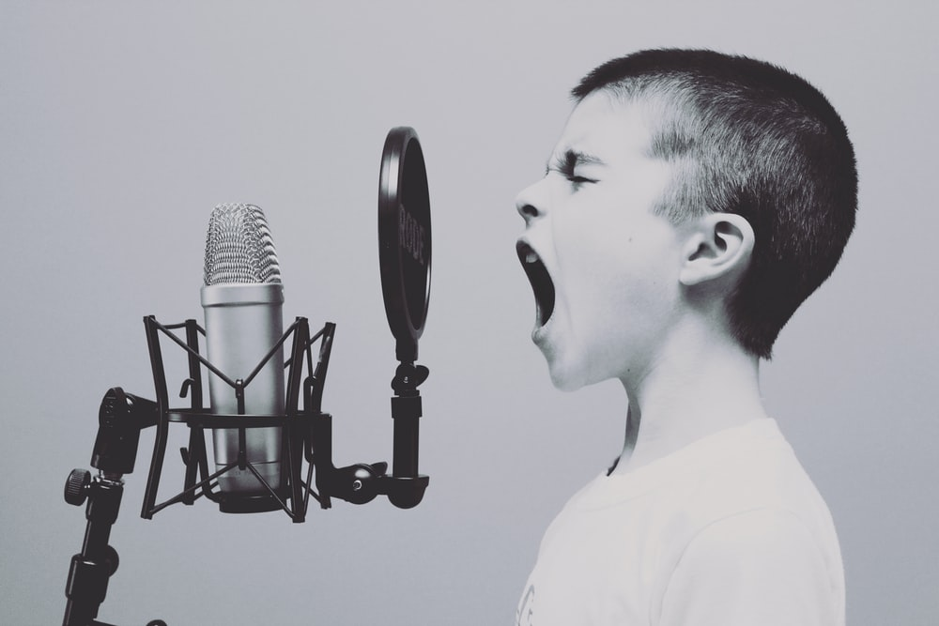
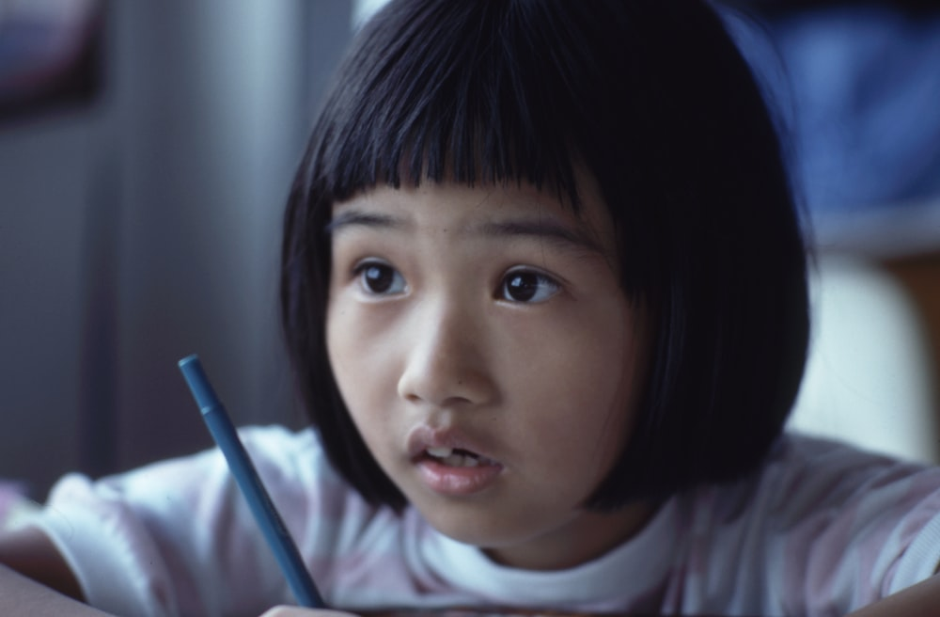
Slide 5

Slide 6

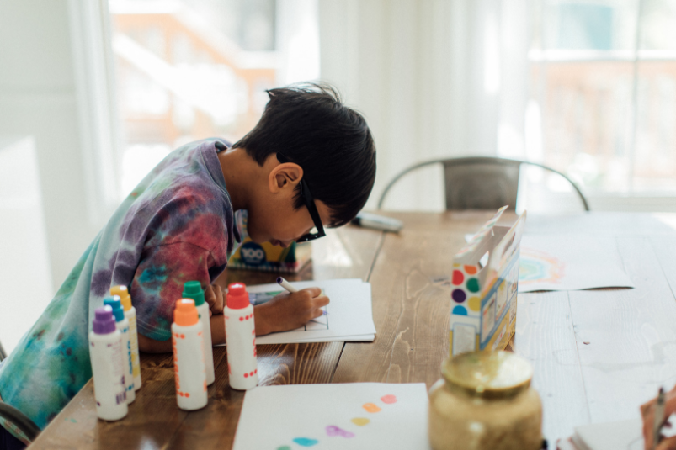
Slide 6
Listen to or read the story “Beautiful Oops” (or one of your own)
Remember, when we express ourselves we don’t have to be a great artist or a wonderful dancer.
It’s not about being the very best at something or putting on a performance.
Let’s encourage each other to find lots of different ways to get creative and express ourselves.
Link to story
https://youtu.be/2fZjMYdQjGM

Slide 7



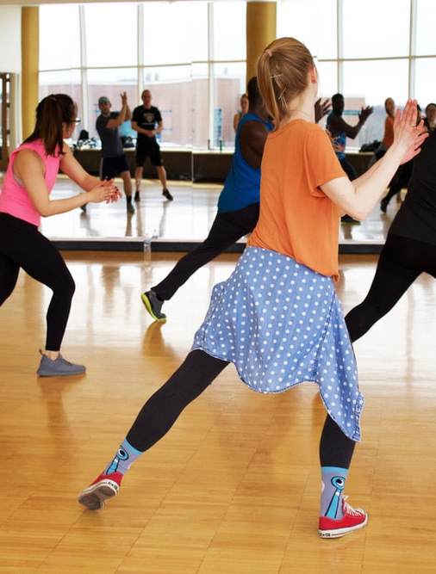
Slide 7

Slide 8
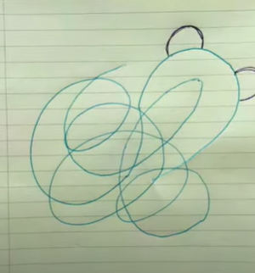
Explore your creativity
Invite pupils to have a go at the one-minute Squiggle game by Place2Be’s Art Room team.
Watch the demo
https://youtu.be/ozKW1M97JXE

Slide 9
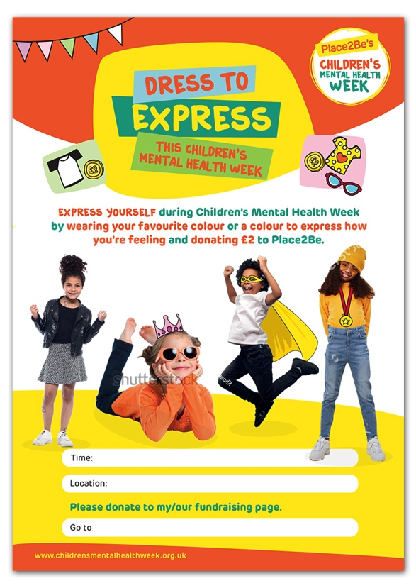
Slide 8
We hope that you join in with our 'Dress to Express Day' on Friday.
If you are not in school, why not send your class teacher a photo of you dressed to express (via Dojo).

